Slide 1

Welcome
To
Pack 232!

Slide 2
Purpose of Tonight’s Meeting
Introduce the Cub Scout program
Present Pack 232’s plan for 2019/20
Identify how you and your child participate in Scouting
Complete Registration

Slide 3
Scouting’s Mission
To prepare young people to make ethical and moral choices over their lifetimes by instilling in them the values of the Scout Oath and Law.
“Fun with a Purpose”

Slide 4
The Scout Oath
On my honor I will do my best to do my duty to God and my country and to obey the Scout Law; to help other people at all times; to keep myself physically strong, mentally awake, and morally straight.

Slide 5
The Scout Law
A Scout is trustworthy, loyal, helpful, friendly, courteous, kind, obedient, cheerful, thrifty, brave, clean, and reverent.

Slide 6
The Outdoor Code
As an American, I will do my best to –
Be clean in my outdoor manners.
Be careful with fire.
Be considerate in the outdoors.
Be conservation minded.

Slide 7
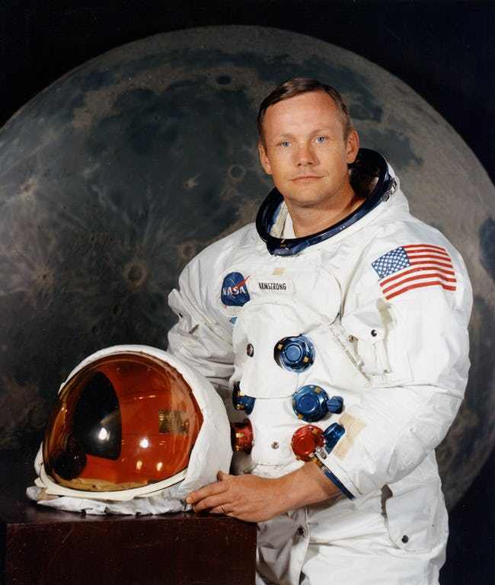
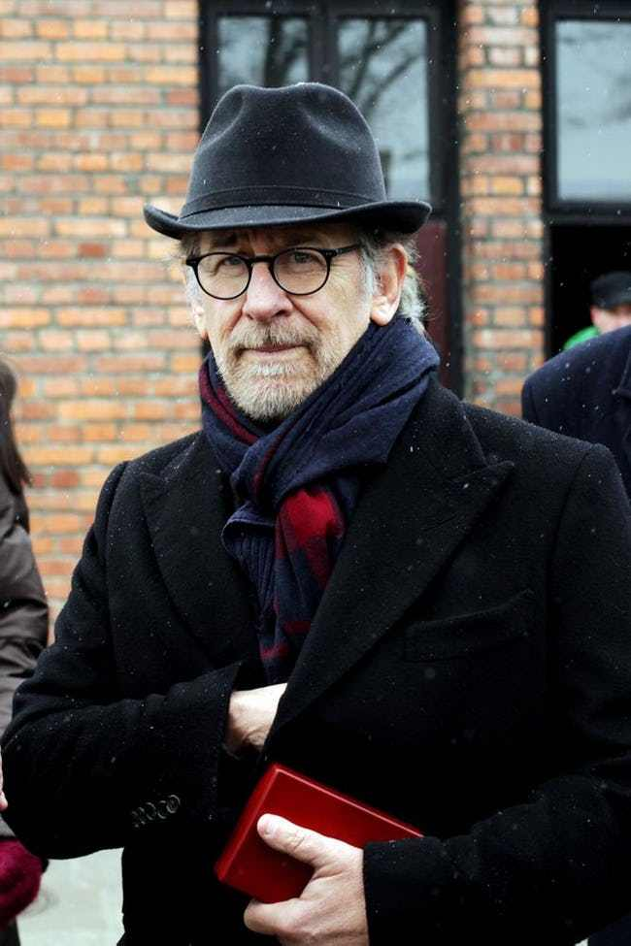
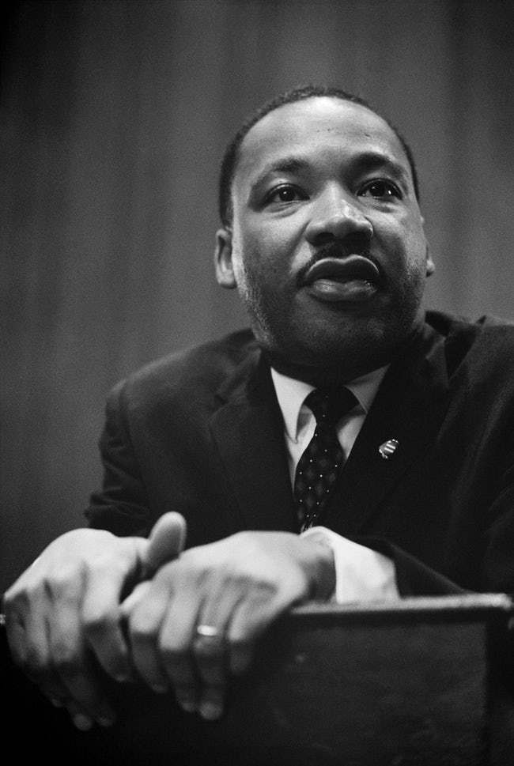
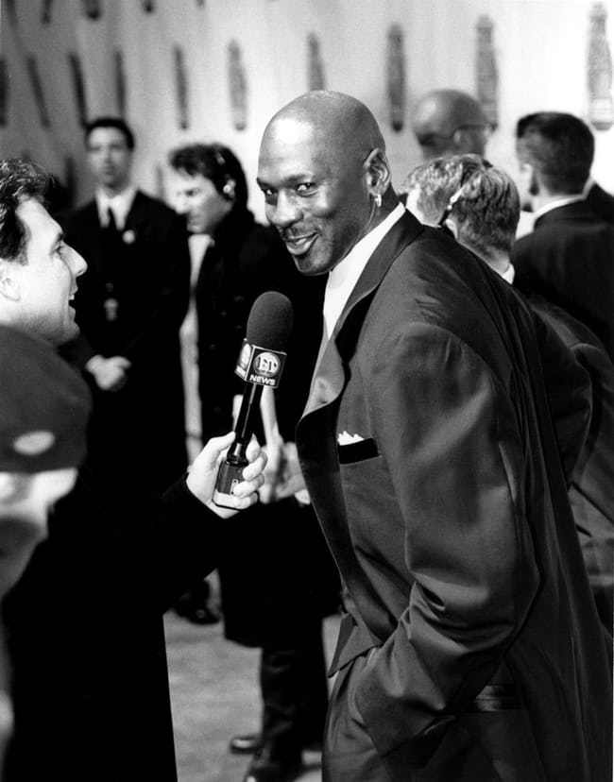
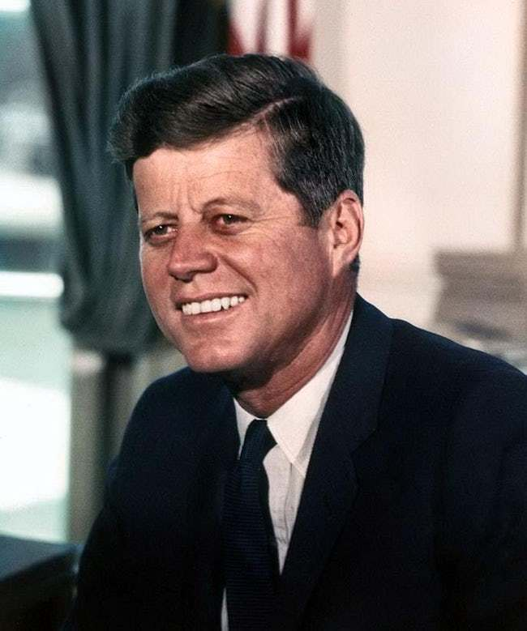
Famous Scouts

Slide 8
Pack 232’s Program for 2019-20
Outings
Family Hikes (Fall/Spring)
District Camporee (Oct)
HEATED CABIN Camping (Feb)
USS Slater Sleepover (May)
Summer Camps (July)
ValleyCats Sleepover (August)
Gatherings
Pinewood Derby (March)
Blue & Gold Picnic (June)
Community Involvement
Scouting for Food (Nov)
Caroling for RMH
Memorial Day Flag Laying
Memorial Day Parade

Slide 9
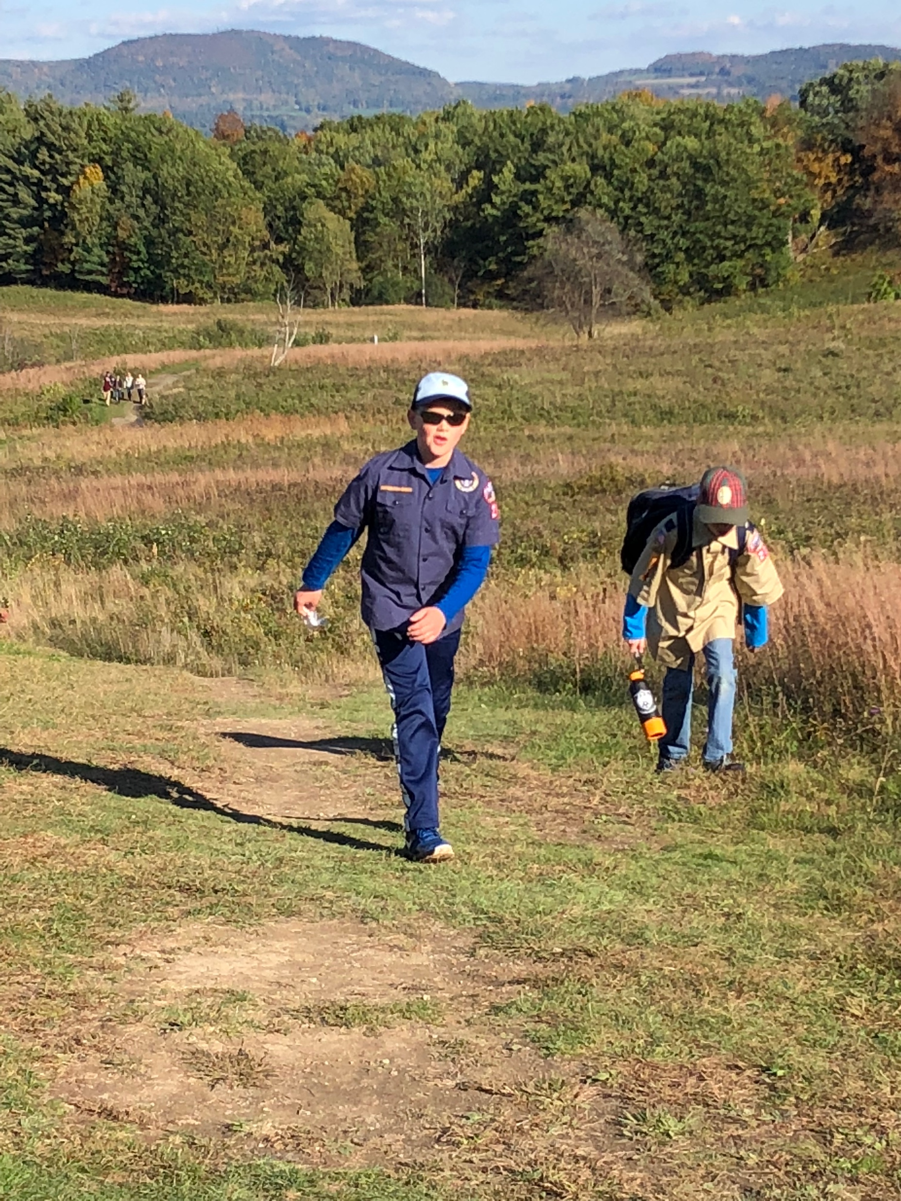
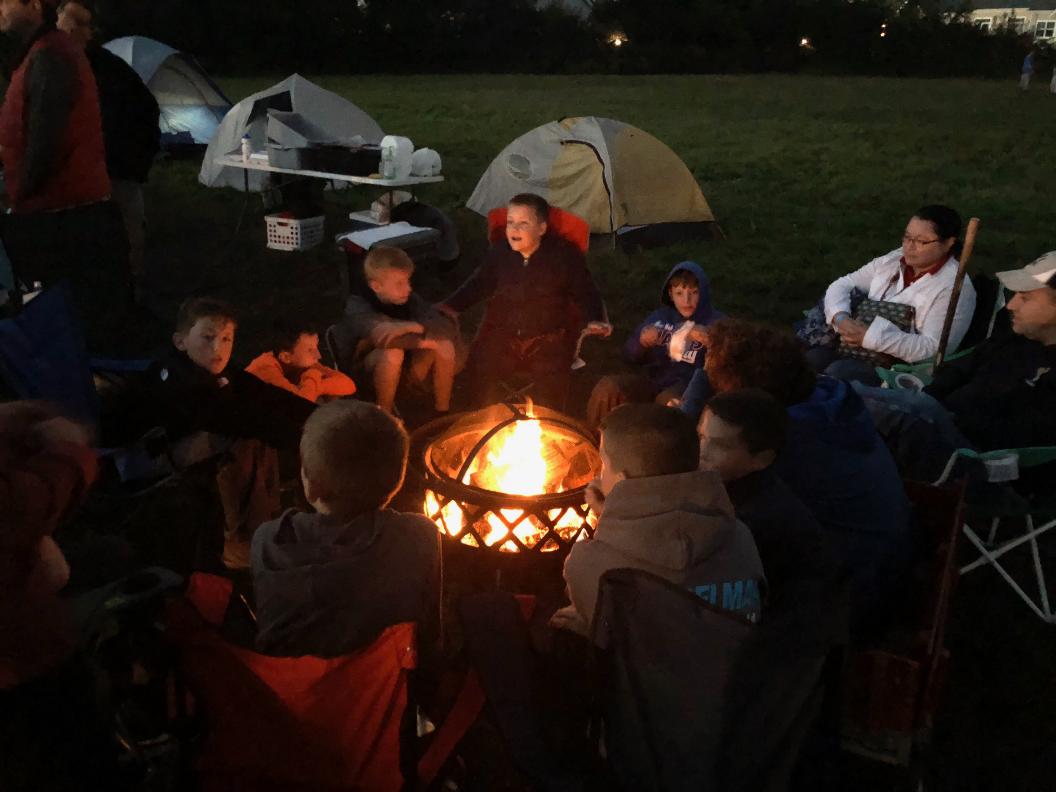
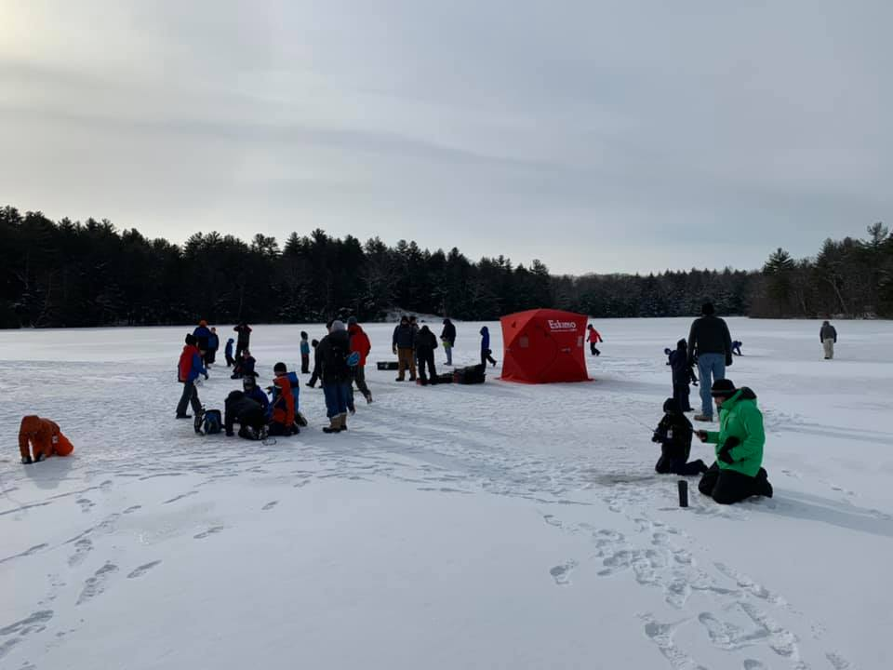
Pack 232 Outings

Slide 10
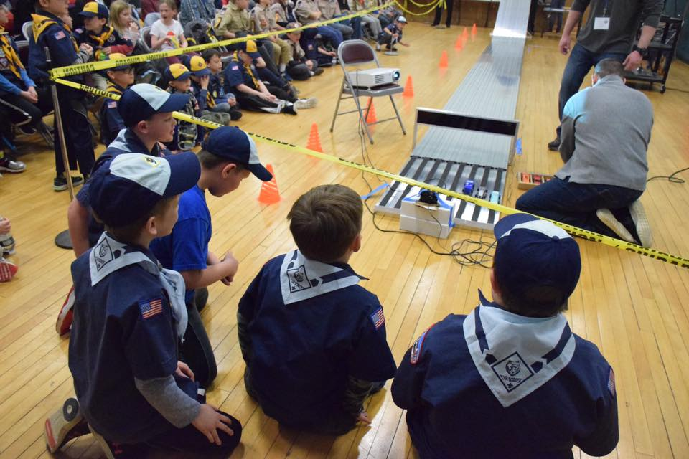
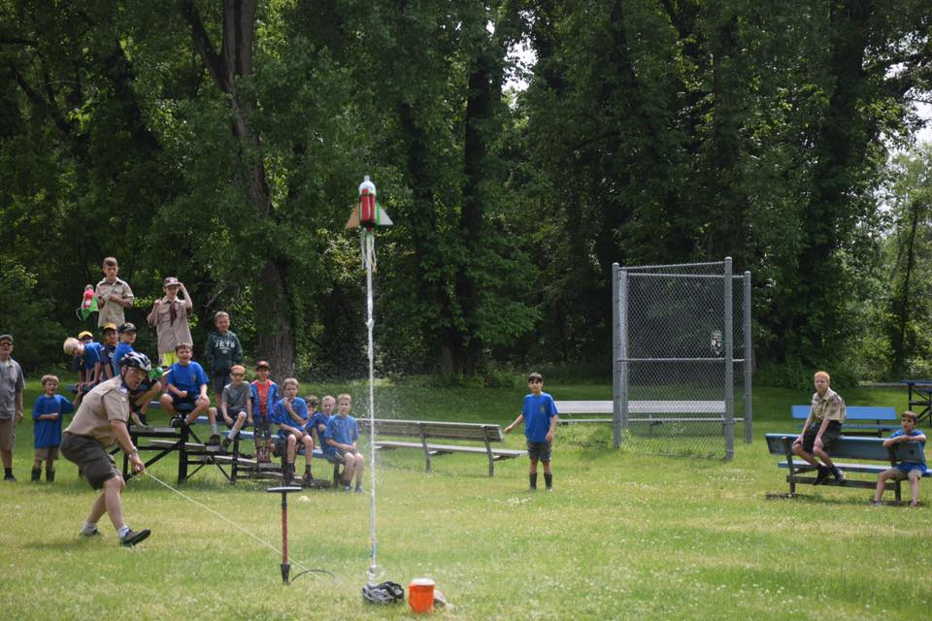
Pack 232 Gatherings

Slide 11
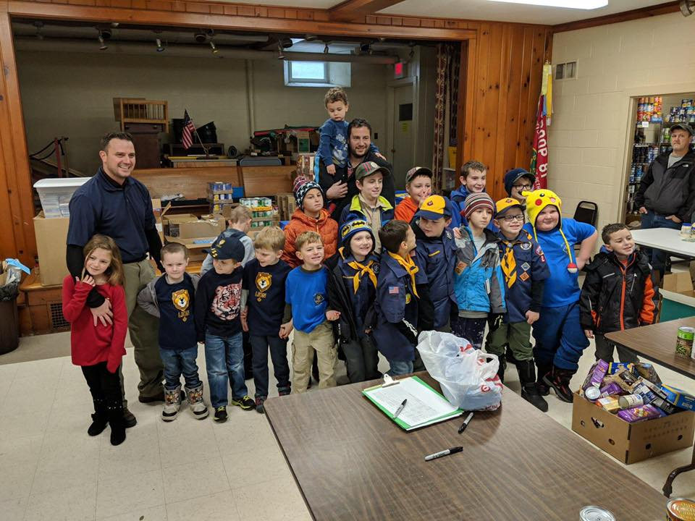
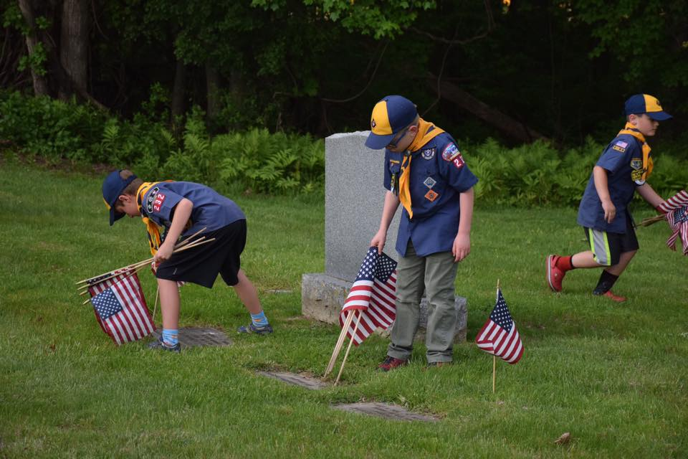
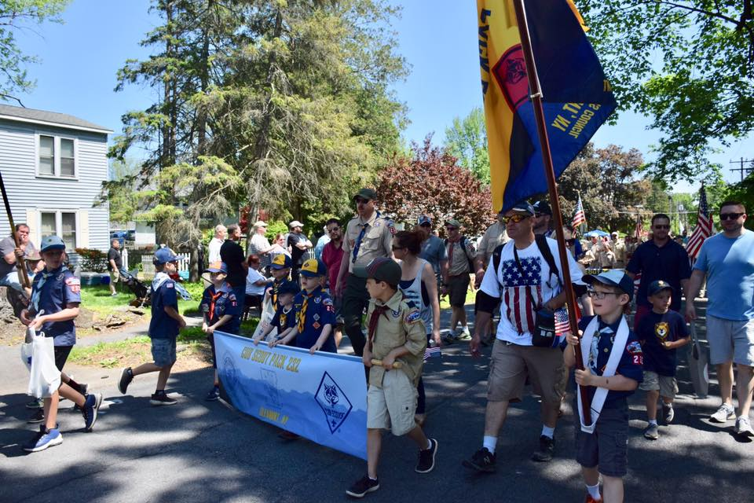
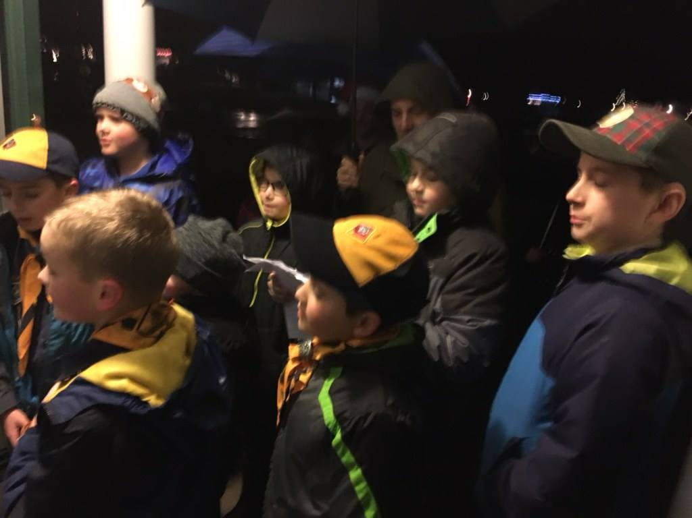
Pack 232 Community Involvement

Slide 12
Cub Scout Advancement Plan
Opportunity for parents to be involved
Scouts learn
Scouts are tested
Scouts are recognized

Slide 13







Cub Scout Rank Advancement
Lion
Kindergarten
Bobcat
1st Advancement
Tiger
1st Grade
Wolf
2nd Grade
Bear
3rd Grade
Webelos
4th Grade
Arrow of Light
5th Grade

Slide 14





Monthly Adventures Advancement

Slide 15
Cub Scout Membership
Boys and Girls join Pack 232
Pack 232 is chartered by the Selkirk Volunteer Fire Company #2
Pack 232 is part of the Fort Orange District in the Twin Rivers Council
Pack 232 was chartered in 1979 but can trace its history back over 85 years
Pack 232 has 47 active scouts and 12 adult leaders (all are BSA trained)
Pack 232 meets monthly on a Tuesday at the Glenmont Elementary School Cafeteria from 6:30-8pm
Meeting activities include: Gathering Activity/Craft, Opening, Special Guest, Game, Awards, Refreshments, and Closing
Members are assigned to a den (same gender and generally same grade).
Meets once or twice a month

Slide 16
Annual Registration Fees
1st Year Cub Scout Registration Fee - $50
Pack is Subsidizing Actual Cost
Returning Cub Scout Registration Fee - $95
Optional - Boy’s Life Magazine Subscription - $12
There can be additional fees for outings
There is financial support for families in need

Slide 17
Fundraising Requirement - Popcorn!
1st Year Cub Scouts do NOT have to sell popcorn
Returning Cub Scouts must sell:
$250 per Scout or
$350 per Scout family
However, there is an option to buy out:
Single Cub Scout - $100
2 or more Cub Scouts in a family - $125 for the family
Cub Scouts sell:
Online,
Door to door, and
Show and Sells
Cub Scout Prizes!!!!:
Pack - Stewarts ice cream cone cert, trampoline outing, bowling outing and rock climbing outing
Council – Great Escape Lodge day
BSA – Amazon Gift Cards

Slide 18

Cub Scout Uniform
Items may be purchased at 253 Washington Ave Ext in Albany or scoutshop.org
Lion’s Book | 9.99
Lion’s T-Shirt | 9.99
Short-Sleeve Shirt (plain) | 24.99
Short-Sleeve Shirt (loaded*) | 41.96
World Crest Emblem | 2.29
World Crest Emblem Ring | 1.99
Neckerchief | 9.99
Slide | 5.99
Cap | 14.99
Web Belt | 9.99
Unit Numerals (232) | 4.47
Scout Spiral Handbook | 16.99
Council Strip Patch | 3.99
We pass down uniform parts each Fall

Slide 19
Where to Get More Info
The Pack website www.pack232.com provides information such as:
Upcoming Events
Pack and Den contacts
Link to Twin Rivers Council (trcscouting.org)
Weekly (Sunday AM) Email Blast
We capture all of our events on our Closed Group Facebook page: Cub Scout Pack 232 of Glenmont, NY

Slide 20
BSA Youth Application
Please open your child’s Cub Scout youth application and begin completing it
Cub Scout fees to collect tonight include:
Registration Fee
Boy’s Life Magazine (optional)
Write checks to “Pack 232”
Notes:
Get your parents to commit. Collecting money is a good sign that your parents are going to continue with the program. If you don’t collect money and applications at the night of your presentation, then set up another meeting time to collect applications and money.

Slide 21

Questions

